Slide 1

Software Quality (Assurance | Engineering)
In the name of Allah, the Beneficent, the Merciful
CSC312 / CSE312

Slide 2
Static and Dynamic Testing
Static testing refers to testing something that’s not running—examining and reviewing it.
Dynamic testing is what you would normally think of as testing—running and using the software
Dynamic testing involves actual execution of code, whereas static testing involves a variety of reviews, such as requirement verification, design review, and code review

Slide 3
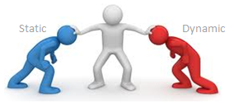
Static vs. Dynamic
Static Testing | Dynamic Testing
Testing done without executing the program | Testing done by executing the program
This testing does validation | This testing does verification
Static testing is about prevention of defects | Dynamic testing is about finding and fixing the defects
Static testing gives assessment of code and documentation | Dynamic testing gives bugs/bottlenecks in the software system
Static testing involves checklist and process to be followed | Dynamic testing involves test cases for execution
Static testing can be performed before compilation | Dynamic testing is performed after compilation

Slide 4
Dynamic Techniques
Different dynamic techniques are performed throughout the development & maintenance
Involve the execution of the software and is effective at error detection when software units are combined at the integrated subsystem and system levels.

Slide 5
Testing
What is testing?
The act of checking if a part or a product performs as expected
Why test?
Gain confidence in the correctness of a part or a product
Check if there are any errors in a part or a product
We need to check our work, because we will make mistakes

Slide 6
Testing
The process of finding deviations of observed behaviour from the expected behaviour.
Apply input
Observe output
Software
Verify the observed output
Is the observed output the same as the expected output?

Slide 7
Testing Philosophy
Testing has a different philosophy compared to other activities in the development life cycle
Testing Is aimed at breaking the system
Ideally should be performed by technical persons who are not involved in the development of the system

Slide 8
Generic Testing Process
The process involves:
Test planning
Test Project
Test Execution
Test Record

Slide 9
Test Planning
All related testing activities are planned and documented
What parts of the product will be tested
What test levels or phases will be covered
Which test technique and criteria will be used in each phase
What necessary resources are required
What is the operational environment
Related schedule of each task

Slide 10
Test Project
Once the test plan is defined it is refined during this stage
Test cases are really created aiming at reaching the desired quality level
Test case generation is the most time consuming activity during testing process

Slide 11
Test Execution
Once the test cases are defined they can be run to collect the test results
For the purpose, the existence of testing tools is almost mandatory since there are several tasks that, if executed manually, are very error prone and subject to human mistakes

Slide 12
Test Record
Finally the results produced during the test execution are documented in the “Test Daily Report”
If any discrepancy observed with respect to the software specification, “Test Incident Report” is filled and corrective actions can be taken
At the end “Test Summary Report” is produced

Slide 13
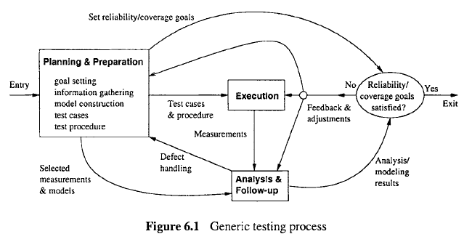
Generic Testing Process

Slide 14
Types of Dynamic Software Testig
There are two major types of software testing
White-box Testing
Gray-box Testing
Black-box Testing

Slide 15
Levels of Testing
Level of Testing | Performed by
Unit (Module) Testing | Programmer
Integration Testing | Development Team
System Testing | Independent Test Group
Acceptance Testing | Customer

Slide 16
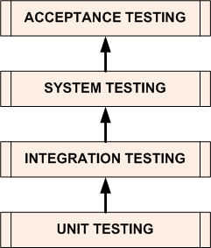
Levels of Testing

Slide 17
Unit Level Testing
UNIT TESTING is a level of software testing where individual units/ components of a software are tested
The purpose is to validate that each unit of the software performs as designed
A unit is the smallest testable part of any software
It usually has one or a few inputs and usually a single output

Slide 18
Unit Level Testing (Continue…)
In procedural programming, a unit may be an individual program, function, procedure, etc.
C, Pascal, VB, Python
In object-oriented programming, the smallest unit is a method and sometimes a class is considered as the smallest unit
C++, Java, Pascal, Python, C#

Slide 19
Integration Testing
INTEGRATION TESTING is a level of software testing where individual units are combined and tested as a group
The purpose is to expose faults in the interaction between integrated units
Test drivers and test stubs are used in it
Integration can be done in many ways;
Top-down Integration Testing
Bottom-up Integration Testing

Slide 20
System Testing
SYSTEM TESTING is a level of software testing where a complete and integrated software is tested
The purpose of this test is to evaluate the system’s compliance with the specified requirements
Black-box testing techniques are used to perform System testing

Slide 21
Acceptance Testing
ACCEPTANCE TESTING is a level of software testing where a system is tested for acceptability
The purpose of this test is to evaluate the system’s compliance with the business requirements and assess whether it is acceptable for use
Performed by the customer in actual operational environment

Slide 22
Types of System Test
Functional Testing
Performance Testing
Stress Testing
Configuration Testing
Security Testing
Recovery Testing
Usability Testing

Slide 23
Other Testing Techniques
Some other popular dynamic testing techniques include;
Model Based Testing
Mutation Testing
Evolutionary Testing
Regression Testing

Slide 24
Any Questions?
Summary

